Slide 1
Risk Assessment on Household Travel Survey Data
December 9th 2020
Leidy Boyce
Data Practicum II
Regis University
Graduate II-Data Analytics | MBAP

Slide 2
Agenda
Project Objectives Household Travel Survey Data Overview Privacy Concerns Results on Privacy Evaluation on NHTS AZ_17* 4.1 Sensitivity attributes evaluation in survey data 4.2 Risks of data sharing to survey participants 4.3 Level of aggregation suitable for TSDC** data set 5. Conclusions 6. Acknowledgements & Questions 7. References
*NHTS AZ_17 = National Household Travel Arizona 2017 **TSDC: Transportation Secure Data Center

Slide 3
1. Project Objectives
1. What are the sensitive attributes in survey data?
2. What risk does data sharing pose to survey participants?
3. What level of aggregation is more suitable for the data set hosted by the TSDC?
TSDC: Transportation Secure Data Center

Slide 4
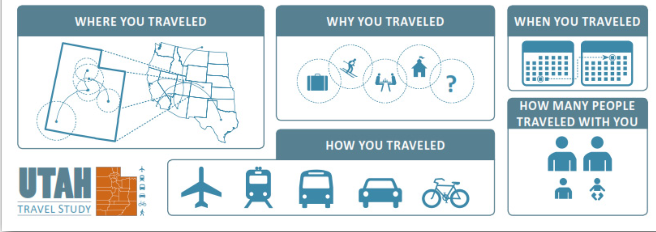
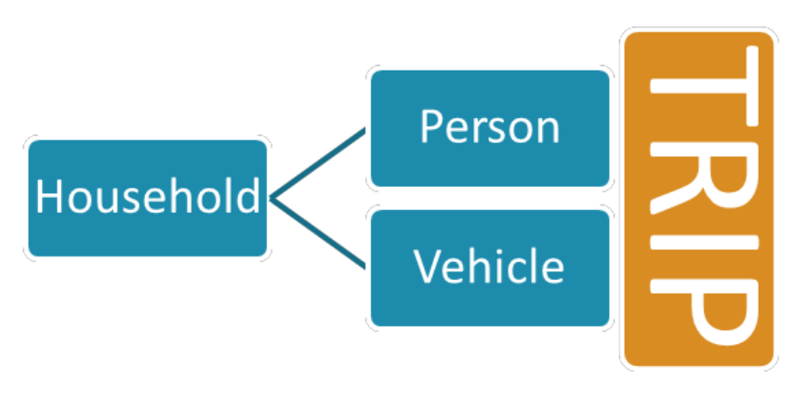
2. Household Travel Survey Data Overview
NHTS Data File Relationship
Picture from: Resources System Group, INC. (2013). Utah Travel Study. https://wfrc.org/MapsData/UtahTravelStudy/UtahTravelStudy_FinalReport_130228.pdf

Slide 5

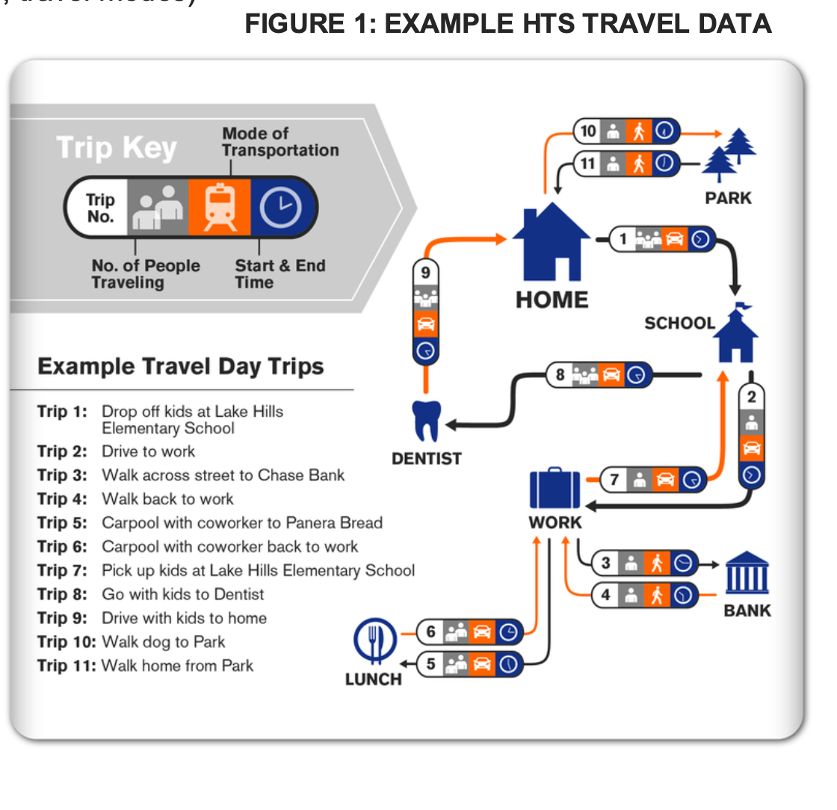
3. Privacy Concerns
Picture sources:
1. Example HTS Travel Data: Introductory Guide To Household Travel Survey Data. (2019). City of Seattle
2. https://ico.org.uk/media/1061/anonymisation-code.pdf
Notes:
Example HTS Travel Data

Slide 6
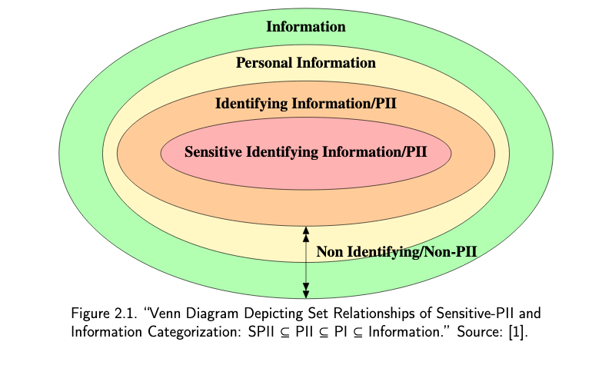
4.1 Sensitivity attributes evaluation in survey data
Information
Quasi_level_2
z
Quasi_level_1
Direct
PII: Personally Identifiable Information
Source: Al-Fedaghi and A. Al-Azmi, “Experimentation with personally identifiable information,” Intelligent Information Management, vol. 4, No. 4, pp. 123–133, July 2012.
Notes:
Not all PII gives the ability to identify someone

Slide 7
4.1 Sensitivity attributes evaluation in survey data
Type of identifier | Definition
Direct | Personally Identifiable Information is any information that either alone, or combined with other sources, can be used to identify an individual. e.g. Home Address
Quasi Identifier Level 1 | Information that is not likely to change over time and be visible and available in other sources. e.g. Sex, Age at baseline, Country.
Quasi Identifier Level 2 | Longitudinal information that is likely to change over time. e.g. Measurements, Events, Opinions, or Prices.
Information | Any other attribute that does not fall in the above categories.

Slide 8
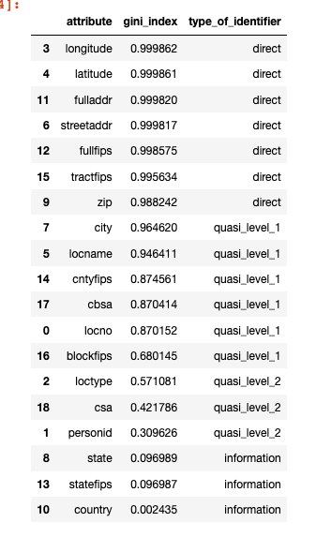
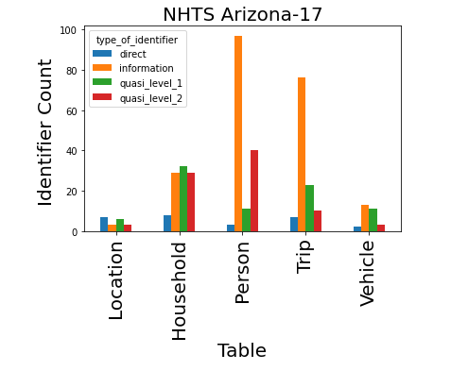
4.1 Sensitivity attributes evaluation in survey data
Location
Table

Slide 9
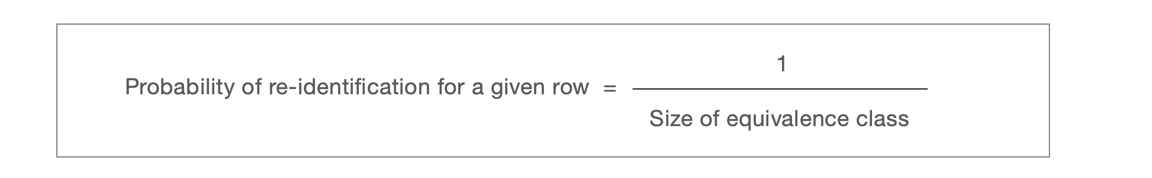
4.2 Risks of data sharing to survey participants
1. Identify the number of equivalent classes in data set (fk).
2. Compute the individual risk per record.
Number | Gender | Education Level | Labor Status | fk | Individual Risk
1 | Male | Secondary | Employed | 2 | 0.5
2 | Male | Secondary | Employed | 2 | 0.5
3 | Male | NA | Employed | 1 | 1
4 | Female | Master | Employed | 1 | 1
Templ, M. (2017). Statistical disclosure control for Microdata: Methods and applications in R. Springer. p. 50.

Slide 10
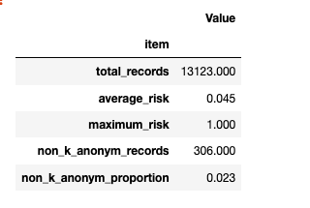
4.2 Risks of data sharing to survey participants
3. Compute Global Risk: which is the expected proportion of all individuals in the sample that could be re-identified by an intruder.
4. Compute Strict average: The combination of average risk and k-anonymity.
*k-anonymity, where k is the smallest equivalence class allowed to be left in the shared dataset.
3.
Rokach, L., & Schclar, A. (2010). k-Anonymized Reducts. IEEE International Conference on Granular Computing, 392-395. https://doi.org/10.1109/GrC.2010.162
Smith, D. G. (2011). Aspects of Statistical Disclosure Control. University of Manchester.

Slide 11
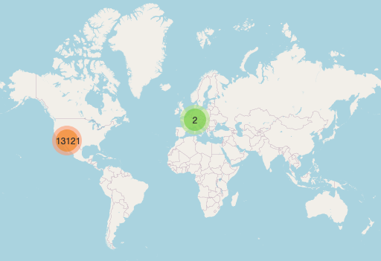
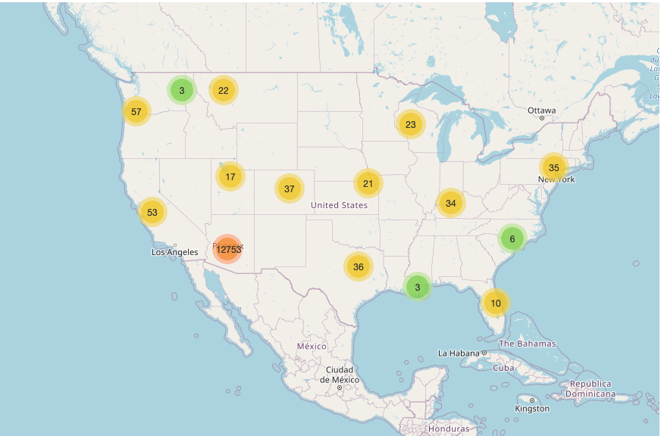
NHTS_AZ 2017 Records: Some participants traveled out-of-state

Slide 12
4.2 Risks of data sharing to survey participants
Number of Records: 13123
Case | Attributes | Global Risk | Max Risk | Non k-anonym Records | # Records After Cell Suppression | Non k-anonym Proportion | Strict Average Risk
Base | Sex, Age, Race Hispanic flag | 0.045 | 1.0 | 306 | 12817 | 0.023 | 0.022
Age Bin | Sex, Bin Age, Race Hispanic flag | 0.012 | 1.0 | 38 | 13085 | 0.003 | 0.008
Zip Code | Sex, Bin Age Race, Hispanic flag Zip code | 0.172 | 1.0 | 1457 | 11666 | 0.111 | 0.068
Census Tracts | Sex, Bin Age, Race, Hispanic flag, Census Tracts | 0.275 | 1.0 | 2301 | 10822 | 0.175 | 0.121

Slide 13
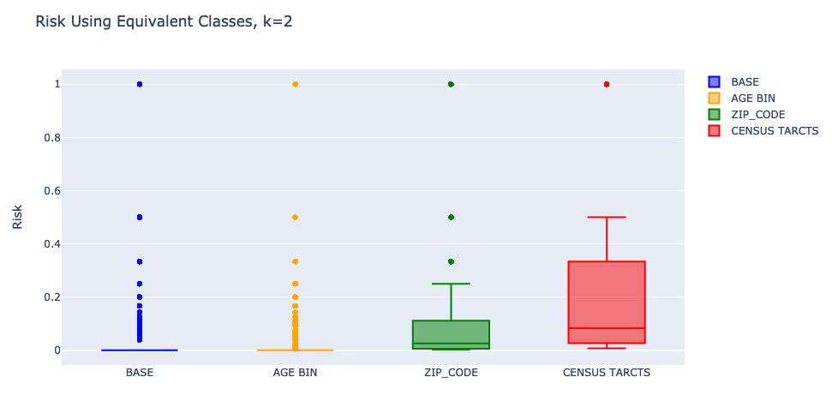
4.2 Risks of data sharing to survey participants
Non k-anonymized 306 38 1457 2301
Records

Slide 14
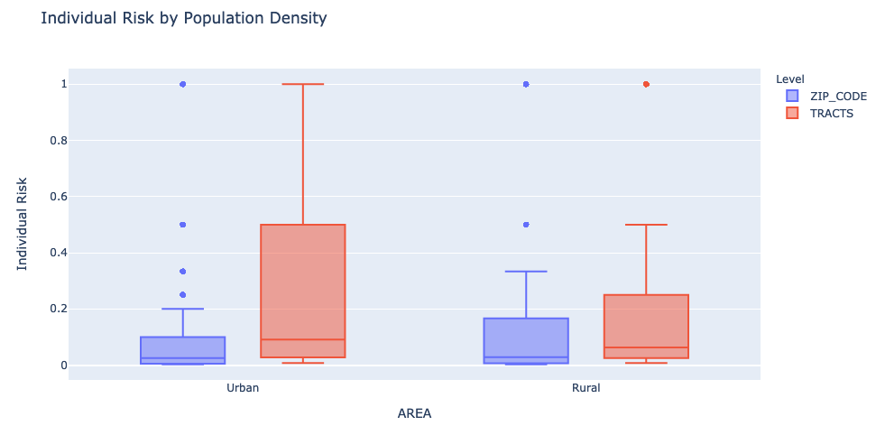
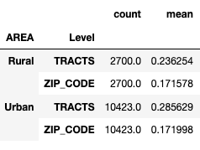
4.2 Risks of data sharing to survey participants
Household's urban area classification based on home address and 2014 TIGER/Line Shapefile

Slide 15
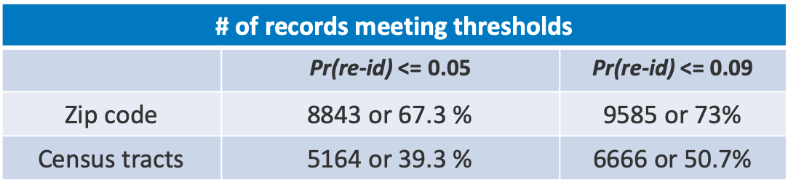
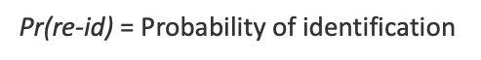
Risk Thresholds
When data has been released publicly, the maximum risk threshold range is between 0.09 and 0.05.
# of records meeting thresholds
 | Pr(re-id) <= 0.05 | Pr(re-id) <= 0.09
Zip code | 8843 or 67.3 % | 9585 or 73%
Census tracts | 5164 or 39.3 % | 6666 or 50.7%
Pr(re-id) = Probability of identification
Emam, K. E., & Arbuckle, L. (2013). Anonymizing health data: Case studies and methods to get you started. O’Reilly & Associates.

Slide 16
4.3 Level of aggregation suitable for TSDC data set
4.3. Disclosure Risk Evaluation by:
4.3.1. Zip Code
Risk of Re-Identification, Entropy base
Inadvertent re-identification (recognition)
4.3.2. Census Tracts
Risk of Re-Identification, Entropy base
Inadvertent re-identification (recognition)

Slide 17
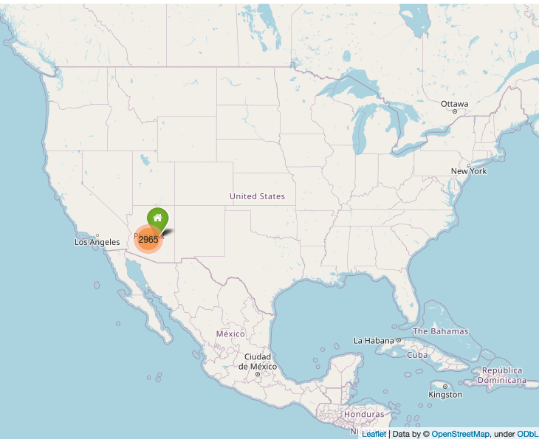
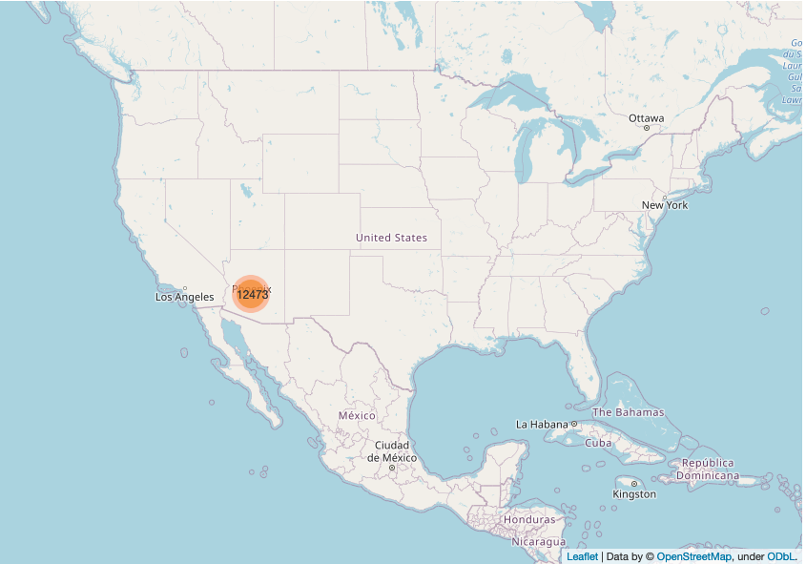
NHTS_AZ 2017 Records
23.7%
Home Locations

Slide 18
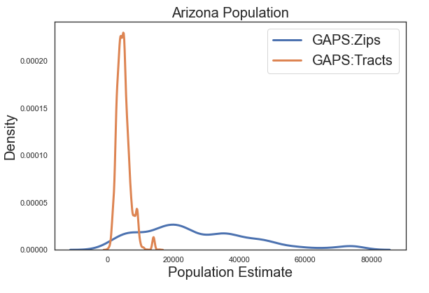
Population Data for Arizona
NHTS_2017_AZ
Number of participants 6,081 | AZ population (2017) 7,016,270
Number of households 2,987 | Total Households in AZ 2,552,972
Census tracts, State of Arizona Census Tracts - 2010/ACS10/TAB10 - Data as of January 1, 2010 https://tigerweb.geo.census.gov/tigerwebmain/Files/tab10/tigerweb_tab10_tract_2010_az.html
2017 zip code data: https://www.nhgis.org

Slide 19
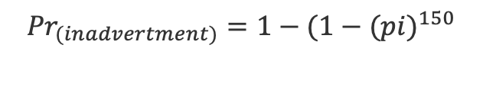
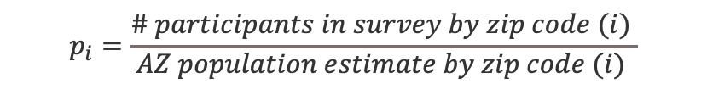
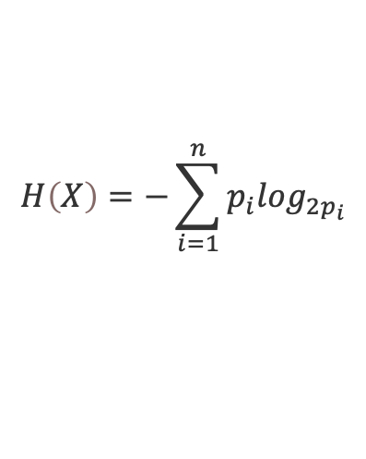
4.3 Risk of Re-Identification Using External Information
Risk of Re-Identification, Entropy base
Inadvertent re-identification
$$H\left(X\right)=−\sum_{i=1}^{n}{p_{i}\log_{2p_{i}}}$$
$$p_{i}=\frac{\# participants in survey by zip code (i) }{AZ population estimate by zip code (i) }$$
$${Pr}_{(inadvertment)}=1−{(1−(pi)}^{150}$$
Antal, L., Shlomo, N., & Elliot, M. (2014). Measuring Disclosure Risk with Entropy in Population Based Frequency Tables. Privacy in Statistical Databases, p. 62-78.
Emam, K. E., & Arbuckle, L. (2013). Anonymizing health data: Case studies and methods to get you started. O’Reilly & Associates.

Slide 20
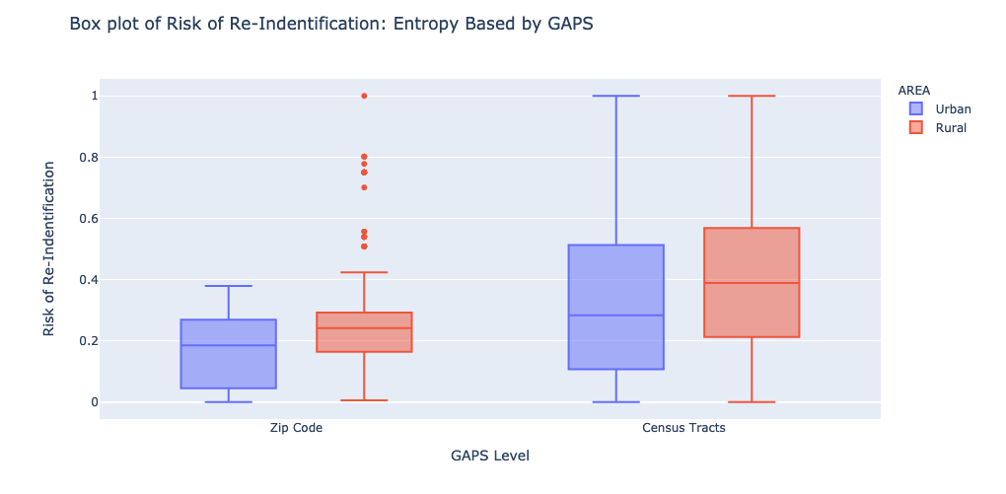
Risk of Re-Identification by population density
Household's urban area classification: Based on home address and 2014 TIGER/Line Shapefile

Slide 21
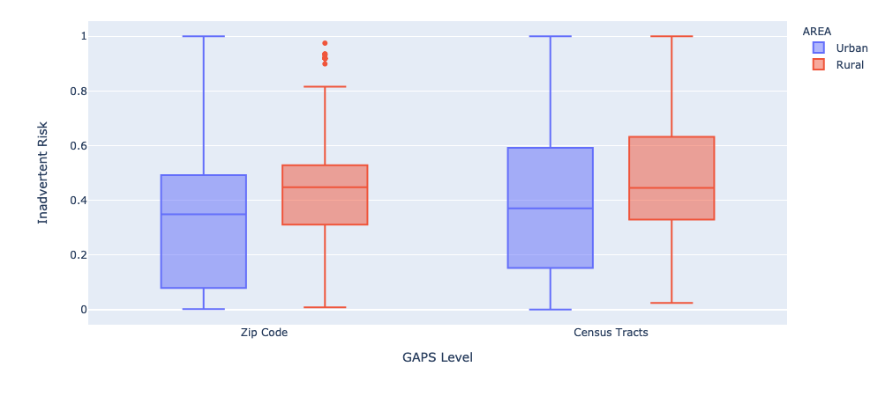
Inadvertent Risk by population density
Household's urban area classification: Based on home address and 2014 TIGER/Line Shapefile

Slide 22
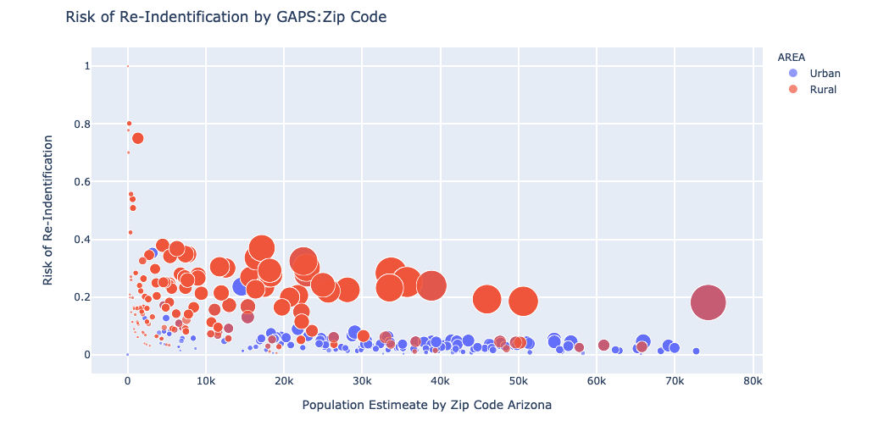
Risk of Re-Identification by Zip Code
Risk cut-off
Population cut-off

Slide 23
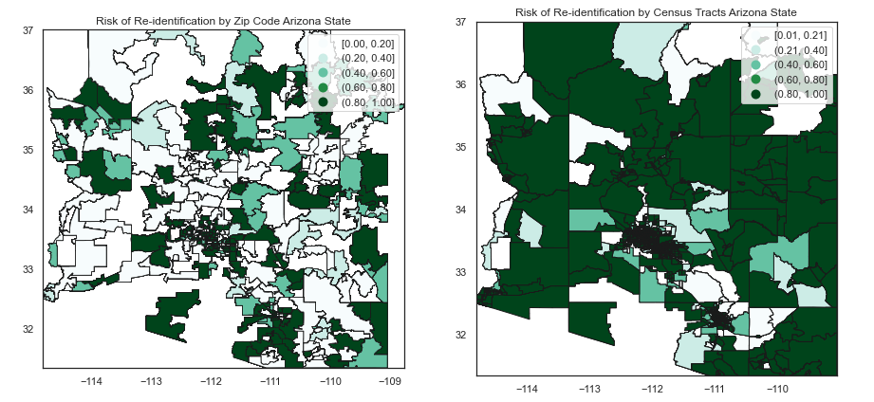
Zip Code and Census Tracts Risk

Slide 24
5. Conclusions
This quantification workflow identifies individuals at high risk allowing TSDC to redact or further aggregate attributes, as needed, to reduce risk.
Quantifying re-identification risk has shown that disclosing census tract data poses higher risk than zip codes for data participants.
Rural areas are at higher risk of re-identification than urban areas.
Buildings or institutions can be uniquely identified and are at higher re-identification risk.

Slide 25

6. Acknowledgements & Questions
Jeff Cappellucci (NREL mentor)
Christy Pierson
My family

Slide 26
7. References
Smith, D. G. (2011). Aspects of Statistical Disclosure Control. University of Manchester.
Rokach, L., & Schclar, A. (2010). k-Anonymized Reducts. IEEE International Conference on Granular Computing, 392-395. https://doi.org/10.1109/GrC.2010.162
Trabelsi, S., Salzgeber, V., Bezzi, M., & Montagnon, G. (2009). Data Disclosure Risk Evaluation. Institute of Electrical and Electronics Engineers (IEEE), 35-42. https://www.ieee.org
Nin, J., Herranz, J., & Torra, V. (2008). On the disclosure risk of multivariate microaggregation. Data & Knowledge Engineering, 67, 399-412. https://doi.org/10.1016/j.datak.2008.06.014
https://www.bogotobogo.com/python/scikit-learn/scikt_machine_learning_Decision_Tree_Learning_Informatioin_Gain_IG_Impurity_Entropy_Gini_Classification_Error.php

